Slide 1



UNIT 3
LESSON 11
Crazy about sports
Part 4

Slide 2
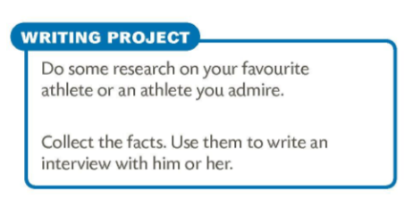
Do you do sports?
Which sports?
How good are you at them?
compete
support
score
natjecati se
podupirati, podržavati
postizati, zabiti
athlete
opponent
competition
coach
instruction
steward
sporting event
referee
fans
goalkeeper
pitch
court
jersey
sportaš
sudac
protivnik
navijači
natjecanje
golman
trener
nogometni teren
uputa, smjernica
teren
upravitelj
dres, sportska majica
sportski događaj

Slide 3
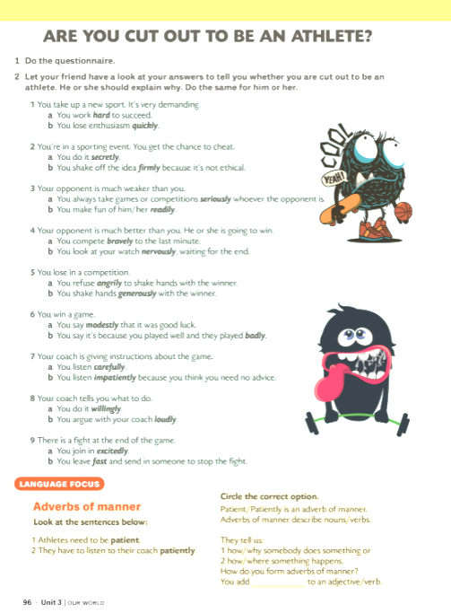

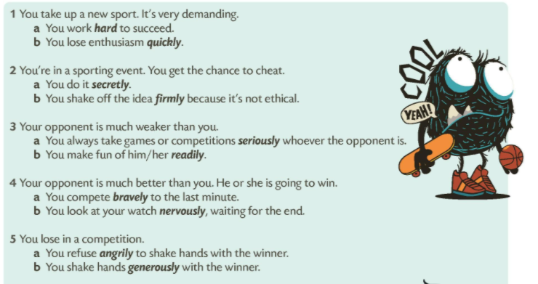
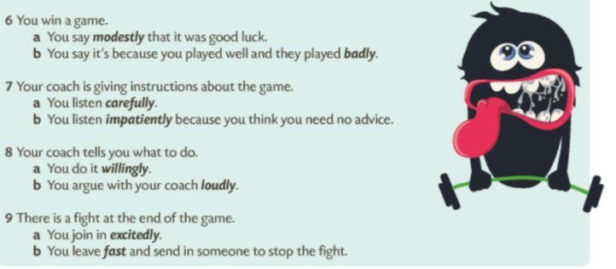

Slide 4
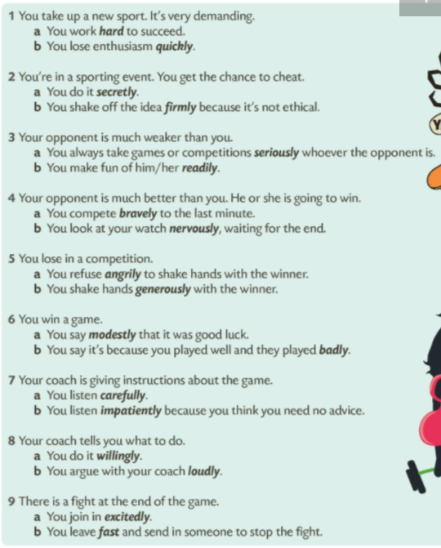
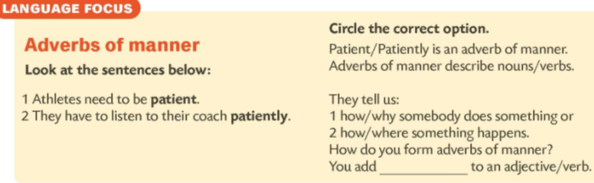
Go through the questionnaire again and underline all the adverbs of manner.
Copy the underlined adverbs in their notebooks.
Choose at least four and make your own sentences with those adverbs.
-ly

Slide 5
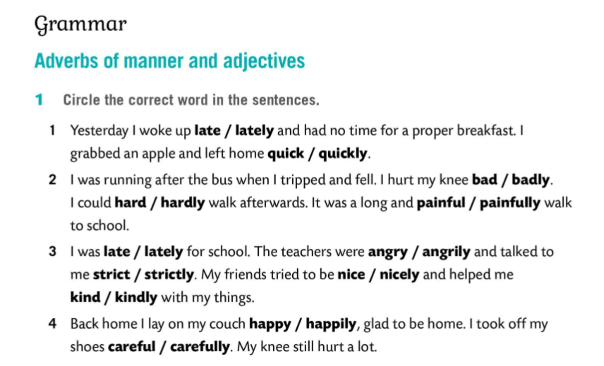
Why is it good to do sports?

Slide 6
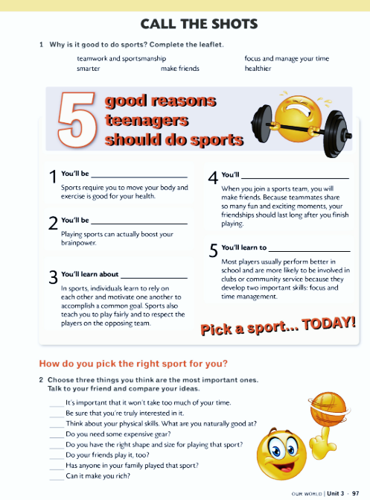
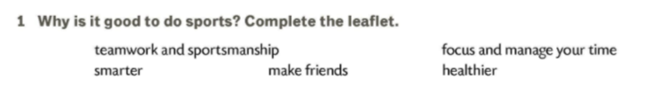
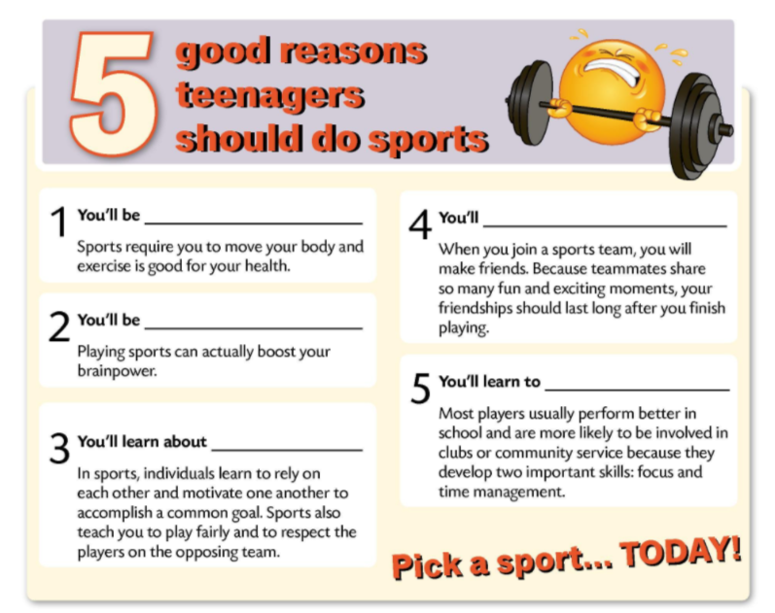
healthier
make friends
smarter
focus and manage your time
teamwork and sportmanship

Slide 7
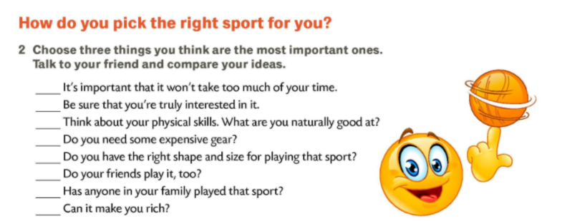

Slide 8
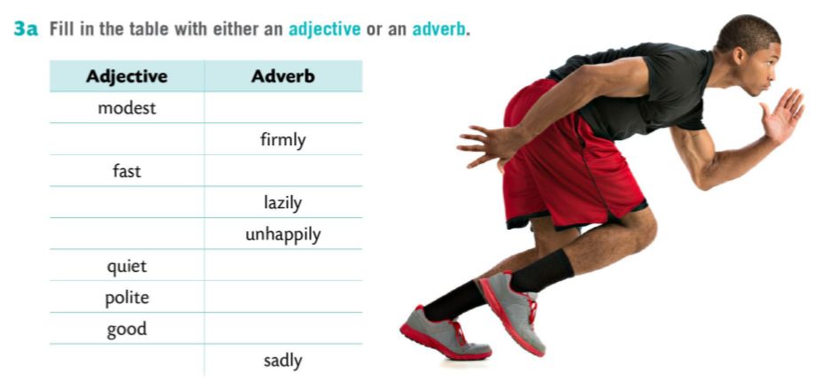
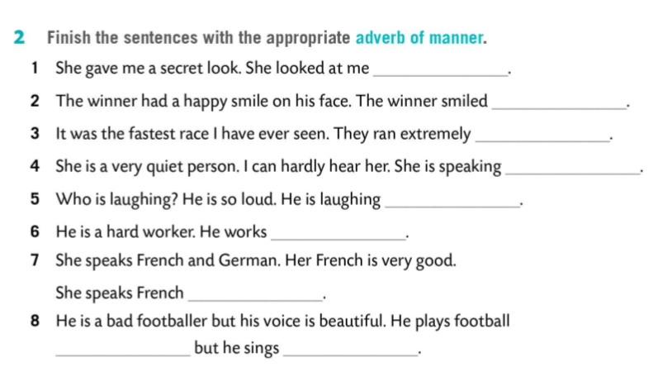
modestly
firm
fast
lazy
unhappy
quietly
politely
well
secretly
sad
happily
fast
quietly
loudly
hard
well
badly
beautifully

Slide 9
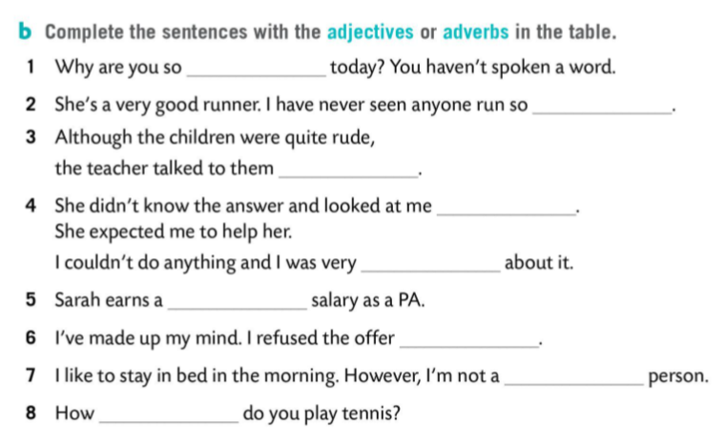

quiet
fast
politely
sadly
unhappy
good
politely
lazy
well

